Slide 1


JOURNEY PPT
21 Aug 2023 - 25 Aug 2023
Name - Utkarsh Dwivedi
Batch - 8

Slide 2
Day 1 – Azure Boards
Azure DevOps
Work Items, Boards and Backlogs
Sprints and Queries
Repos, Pipelines and Test Plans
Creating a new work item
Stages in taskboard
Story pointing
Estimation techniques in Agile
Fibonacci and T-shirt sizes techniques
Flipkart Scrum Project in Azure DevOps

Slide 3
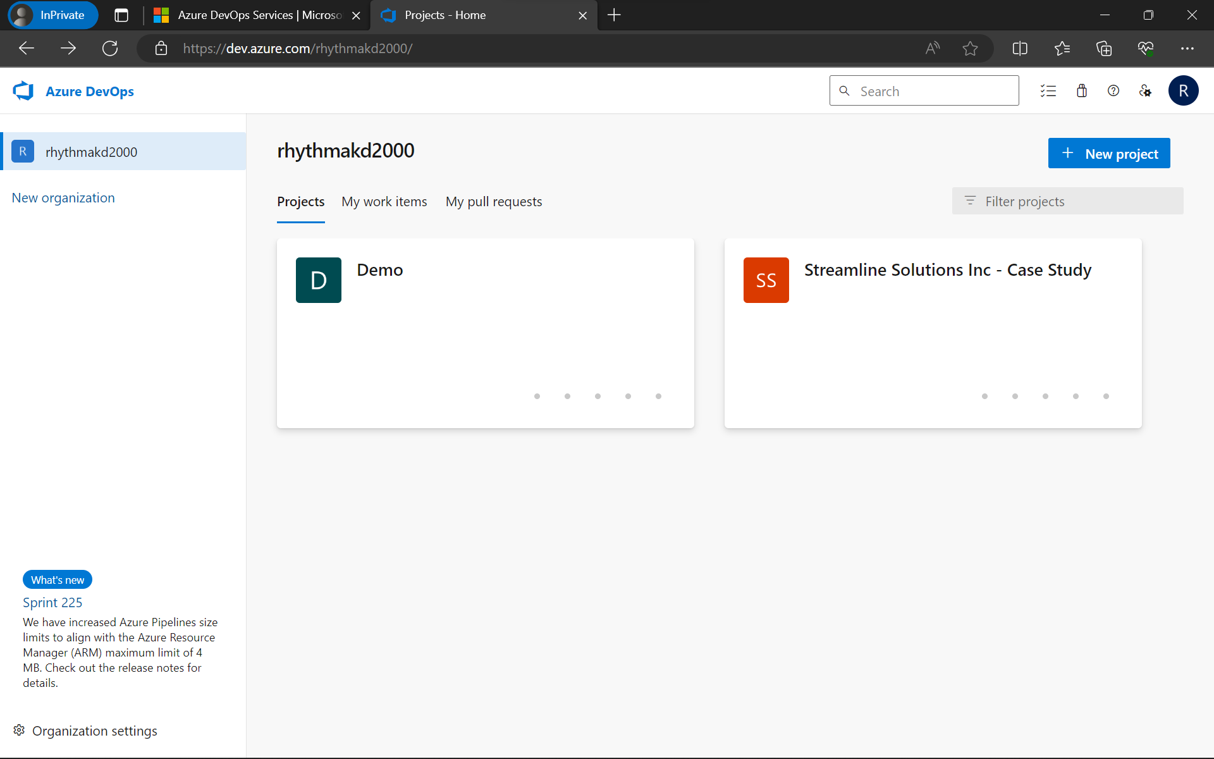

Slide 4
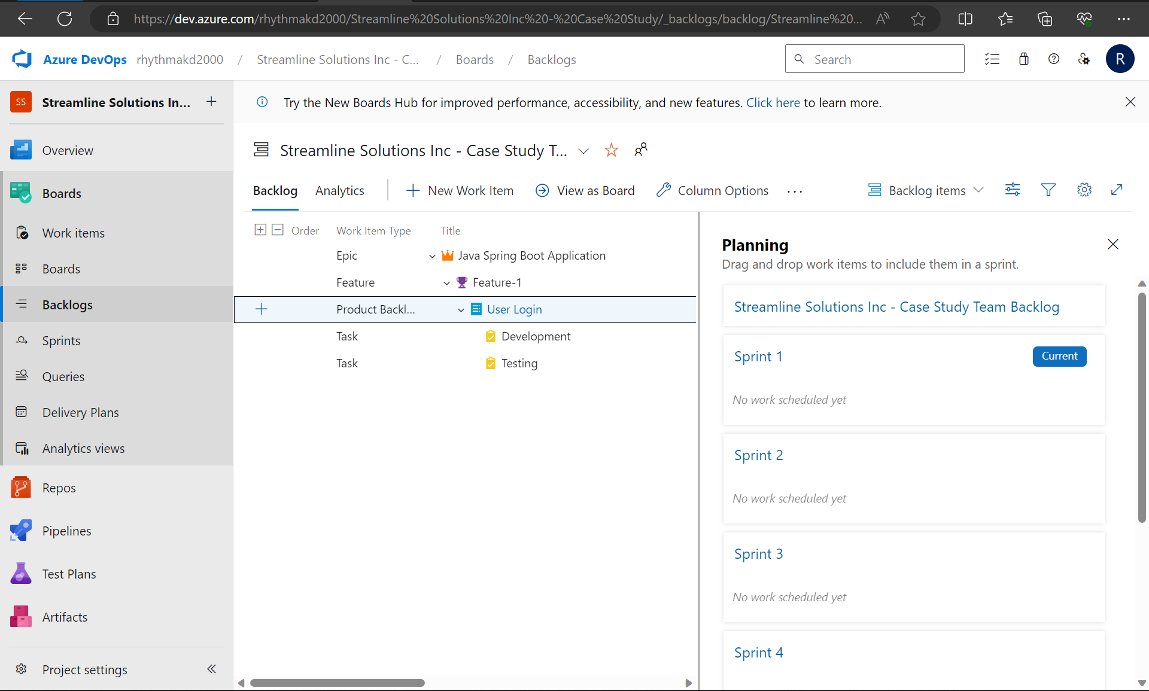

Slide 5
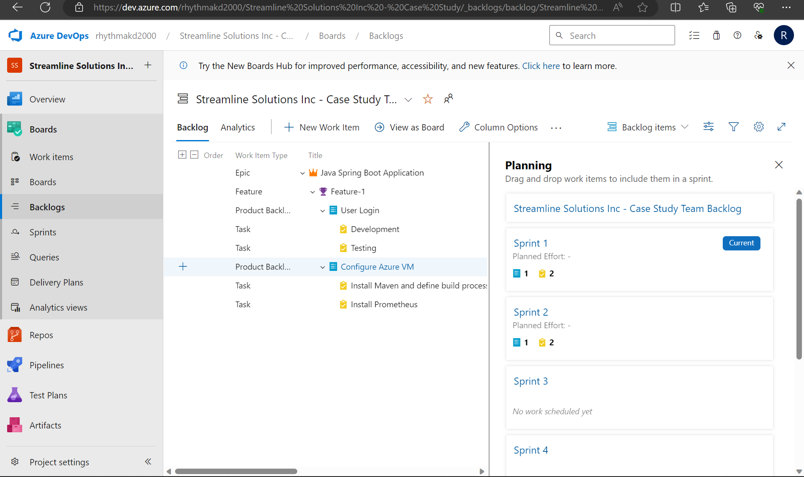

Slide 6
Day 2 - DBMS
DBMS
PostgreSQL Introduction
NoSQL Introduction
Normalization
Virtual Machine Connection
Creation of Online Shopping Database in the Terminal
PSQL Basic Commands, Clauses and Statements
Joins and Subqueries

Slide 7
Day 3 - Testing
Software Testing
Need for testing and Types of testing
STLC and its phases
Test plan components
Entry and Exit Criteria
Role of tester
Testing levels and classification
Statement and Code Coverage
Order of Testing
Smoke, System and Sanity Testing
Regression Testing and Retesting

Slide 8
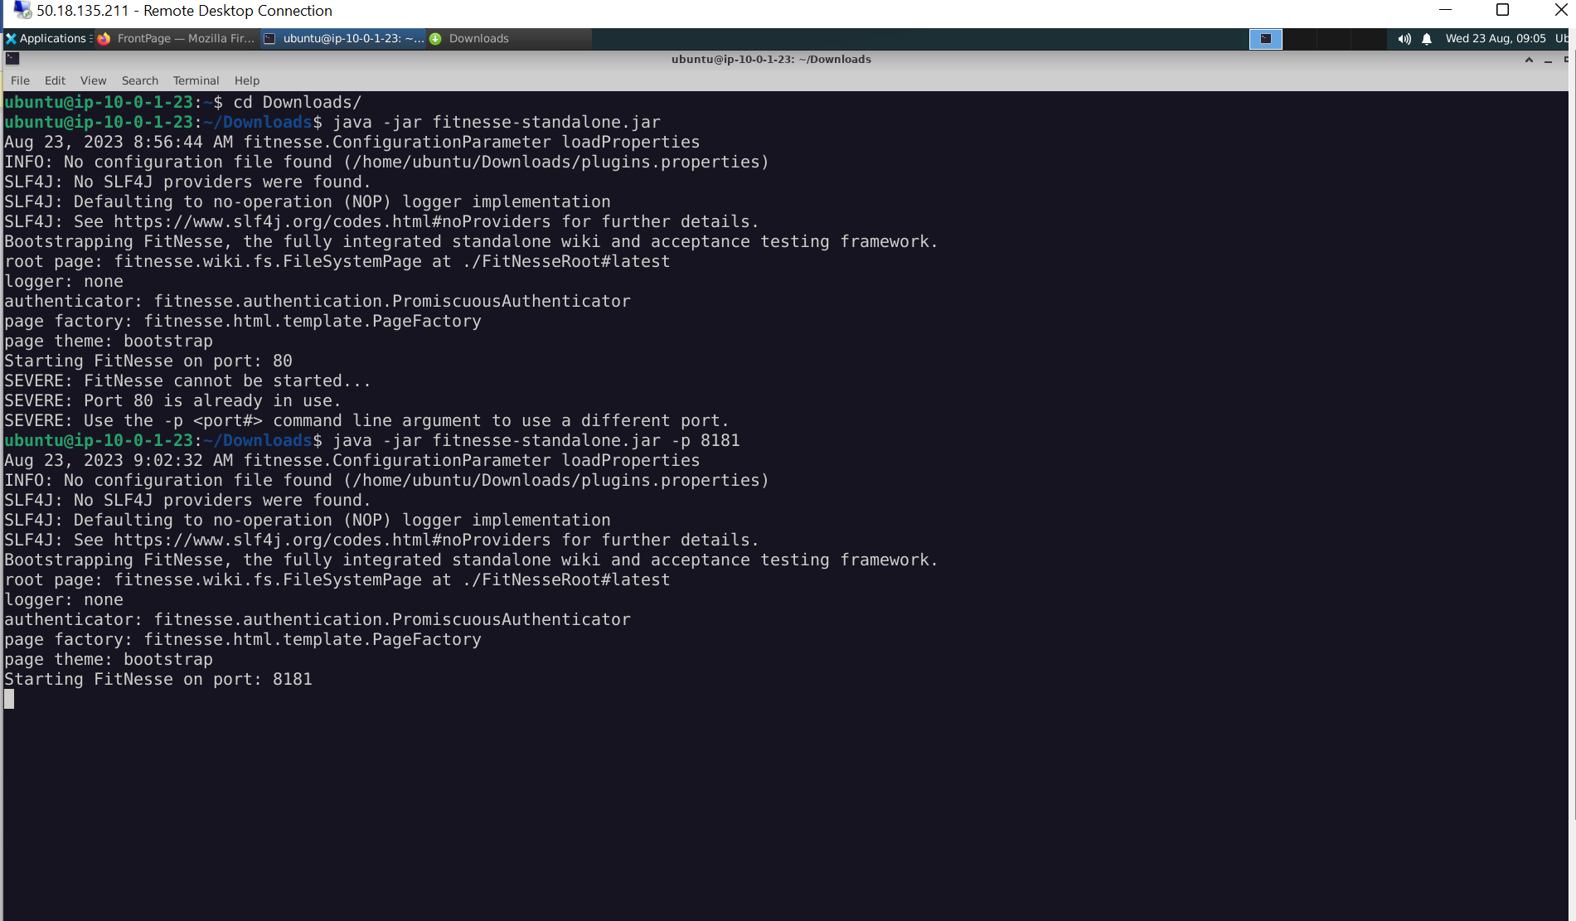

Slide 9
Day 4 - DevOps
DevOps
DevOps Lifecycle
Comparing Agile and DevOps models
CI/CD
DevOps Stages
Servers and Environments
Jenkins Pipeline
GitHub Actions and Workflows
Basic Git Commands
Version Control System

Slide 10
Day-4 continued…
Main and Feature branches
Commit changes and Pull Request (PR)
File Structure
yaml file
Docker Account Creation
Usage of Docker

Slide 11
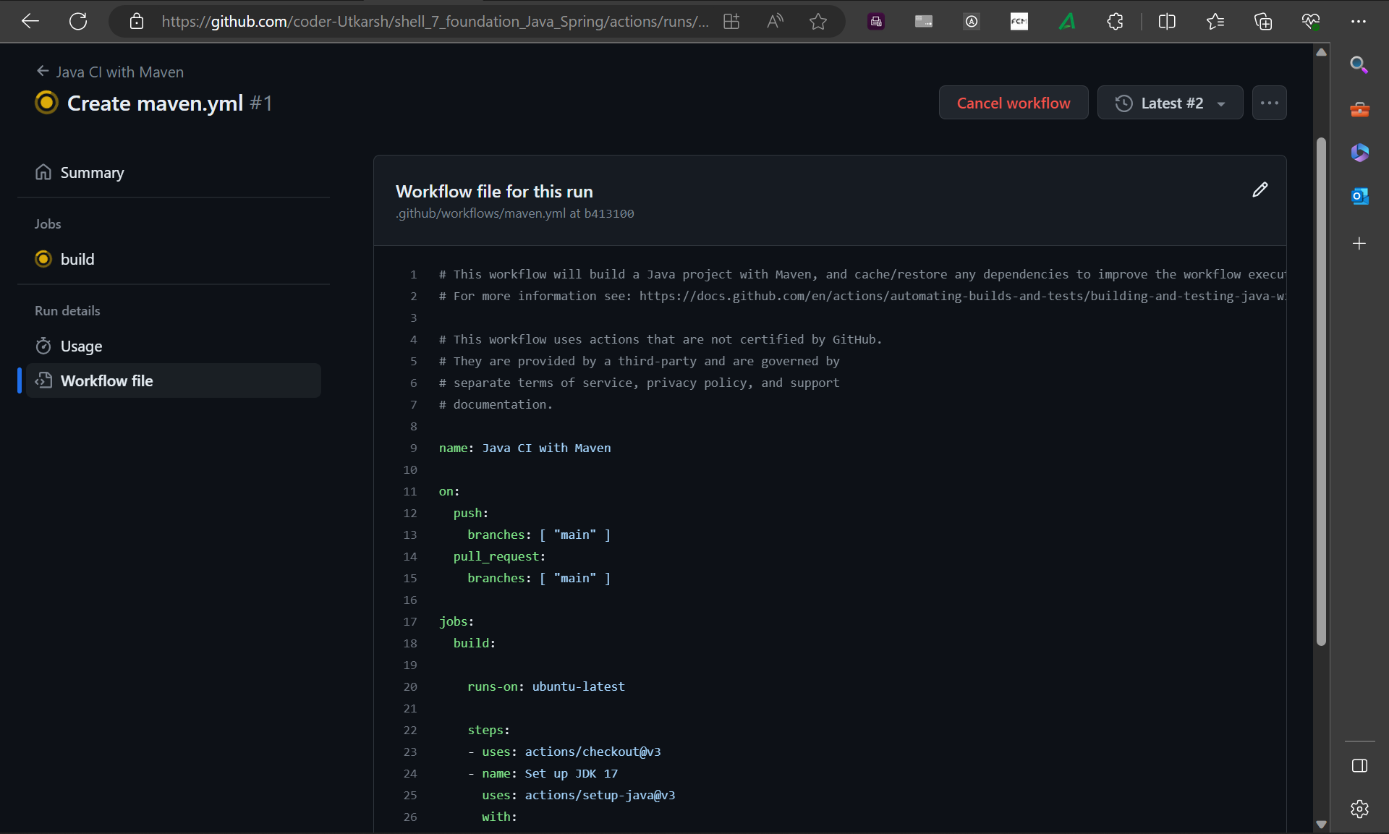

Slide 12
Day 5 - Cloud
Updating demo.yml to build Maven project
Docker Image and Docker Containers
Docker Registry and Architecture
Finishing the yaml file
Logging in to Azure account
Creating a VM in Azure

Slide 13
